Slide 1
Unit 5 :
Performing advanced queries
Session 1
Databases

Slide 2
Join table queries
So far we have only seen queries made on a single table .
It is very frequent and necessary to have to perform queries on table combinations since we need to obtain data in the query of several tables and/or have conditions applied to data from several tables.
For example, in the rental database, to obtain the first and last name of customers who have rented cars in January, we need to use or combine two tables in the query: customers and contracts.
In MySQL we can use the following table join operations:
Cartesian product or CROSS JOIN
INNER JOIN combination
LEFT JOIN combination
RIGHT JOIN combination

Slide 3
Table combination
The internal meeting. INNER JOIN

Slide 4
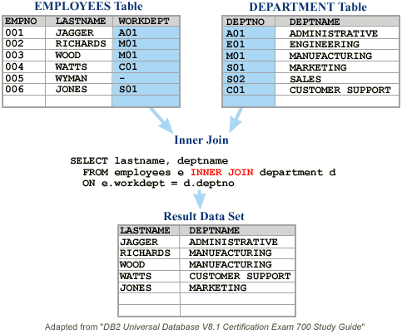
Internal Meeting. INNER JOIN
Allows you to match rows from two tables through a relationship between a column in one table and another column in another table.
Typically, they are the primary key of one table and the corresponding related foreign key in the other table, although they may be columns that have no established foreign key relationship.
In a query of this type, for each row of one of the tables, the other table is searched for the row or rows that meet the desired relationship condition between the two columns (normally equality between primary key and foreign key is searched). .

Slide 5
Internal Meeting. INNER JOIN
The syntax of this operation within a SELECT is:
SELECT ...... FROM table1 INNER JOIN table2 ON column1 relationship_condition column2
Table 1 and table 2 could even be the same table if there is some relationship between a column in the table and the primary key of the same table. In this case, at least one of the table names would have to be an alias.
Column1 and column2 are the columns that are matched or related and must have the same data type or compatible data.
Condition_relation r epresents any relational operation, although equality is normally used. More than two tables can be combined using multiple INNER JOINs.

Slide 6
Internal Meeting. INNER JOIN
Syntax:
SELECT ...... FROM table1 INNER JOIN table2 ON column1 relationship_condition column2
When the names of the two related columns match, we will have to write qualified names, writing the name of the table to which they belong, a period and the name of the column. In that case, this syntax can also be used and is more appropriate:
SELECT ...... FROM table1 INNER JOIN table2 USING (column);

Slide 7
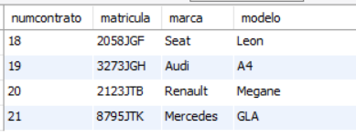
Internal Meeting. INNER JOIN
Example: Obtain the contract number and license plate, make and model of all the cars that are currently contracted by a client.
SELECT contract number, automobiles. registration, make, model FROM contracts INNER JOIN automobiles ON contracts.registration = automobiles.registration WHERE ffin IS NULL;

Slide 8

Internal Meeting. INNER JOIN
Example: Obtain the contract number and the first and last name of all customers who currently have a car contract.
SELECT contractnum, firstname, lastname FROM clients INNER JOIN contracts ON dnicliente=dni WHERE ffin IS NULL;

Slide 9
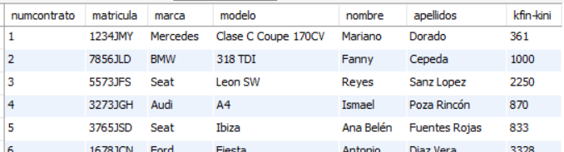
Internal Meeting. INNER JOIN
Example: From all completed contracts, obtain the license plate, make and model of each contracted car, the name and surname of the client who made each contract and the kilometers traveled by the car in the contract.
SELECT contract number, automobiles. registration, make, model, name, surname, kfin-kini FROM (INNER JOIN automobile contracts ON contracts.matricula = automobiles.matricula ) INNER JOIN clients ON dniclient = dni WHERE ffin IS NOT NULL;

Slide 10
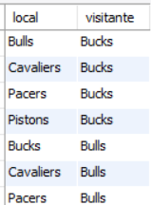
Internal Meeting. INNER JOIN
NBA database we have a teams table. In the teams table, among other data, you have the name of the team and the division in which it participates. Obtain all the possible confrontations or matches between teams in the central division without using the match table, looking for the different crosses.
SELECT a.local AS name , b.visitor AS name FROM AS teams a INNER JOIN AS teams b ON a.name <> b.name WHERE a.division ='central' AND b.division ='central' ;
Explanation: We have an INNER JOIN between two tables that are the same. We renamed the first one as table a and the second as table b, but they are both teams.

Slide 11
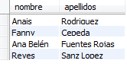
Internal Meeting. INNER JOIN
Seat brand cars .
SELECT DISTINCT first name, last name FROM (INNER JOIN automobile contracts ON contracts.matricula = automobiles.matricula ) INNER JOIN clients ON dniclient = dni WHERE mark=' seat ' ;
select first name, last name from clients inner join contracts as with on clients.dni = con.dniclient inner join automobiles on with.matricula = automobiles.matricula where mark=' seat ';

